Slide 1
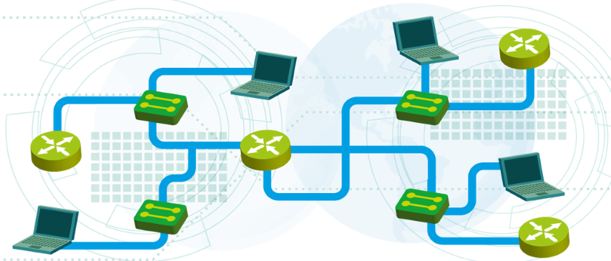

Course summary
Module 8
SoftUni Team
Technical Trainers
Software University
http://softuni.bg

Slide 2
Questions
sli.do #NetFund

Slide 3
Table of Contents
Introduction to networking
IP addresses and host-to-host communication
Network access, security and VLANS
Layer 2 redundancy – STP
IP services and basic routing
Dynamic routing with OSPF
Practice

Slide 4
Introduction to networking

Slide 5
How did it start?
ARPANET - The Advanced Research Projects Agency NETwork
Established in 1969
It is the first packet switching network which will use TCP/IP
It was designed for scientific purposes and to share computer resources
It did not start as military purpose network and it was not designed to survive a nuclear attack

Slide 6
Common Types of Computer Networks
Local Area Network (LAN)
Wide Area Network (WAN)
Wireless Local Area Network (WLAN)
Storage Area Network (SAN)
Home Area Network (HAN)

Slide 7
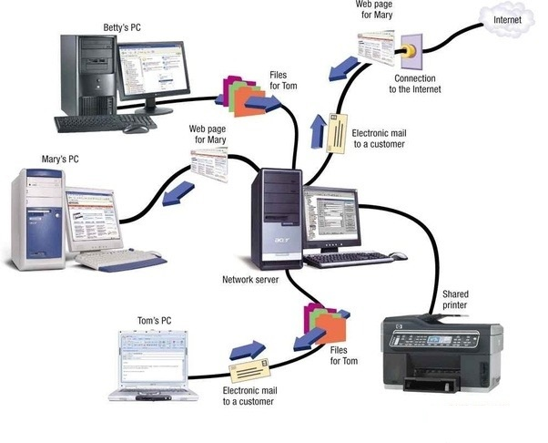
Local Area Network (LAN)
Connects network devices over a relatively short distance
Very useful for sharing resources such as data storage and printers

Slide 8
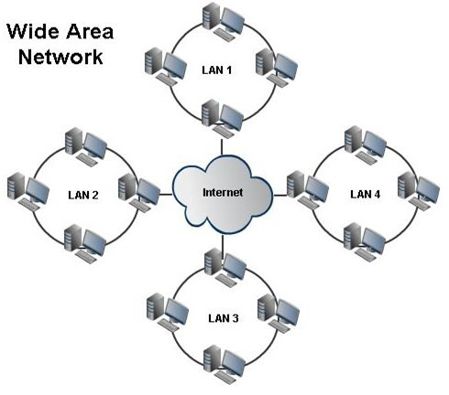
Wide Area Network (WAN)
Connects multiple LANs together
Extends over a large geographical distance
The Internet is the largest WAN spanning the Earth

Slide 9
Common Types of Networking Devices
Hub (obsolete, not secure and very slow)
Switch
Router
Modem
Firewall
Bridge (like a Switch, fewer ports)
Repeater (like a Hub, it just amplifies the signal)

Slide 10
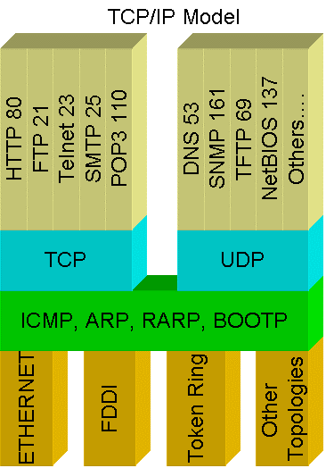
Networks Protocols
Define a common format and set of rules for exchanging messages between network devices
Common protocols:
HTTP
FTP
SMTP
DNS
DHCP
RDP

Slide 11
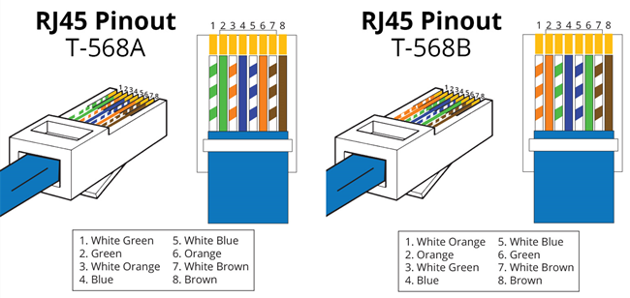
EIA/TIA Standards
EIA = Electronic Industries Alliance TIA = Telecommunications Industry Association
T568B is most frequently used

Slide 12
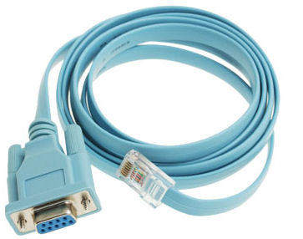
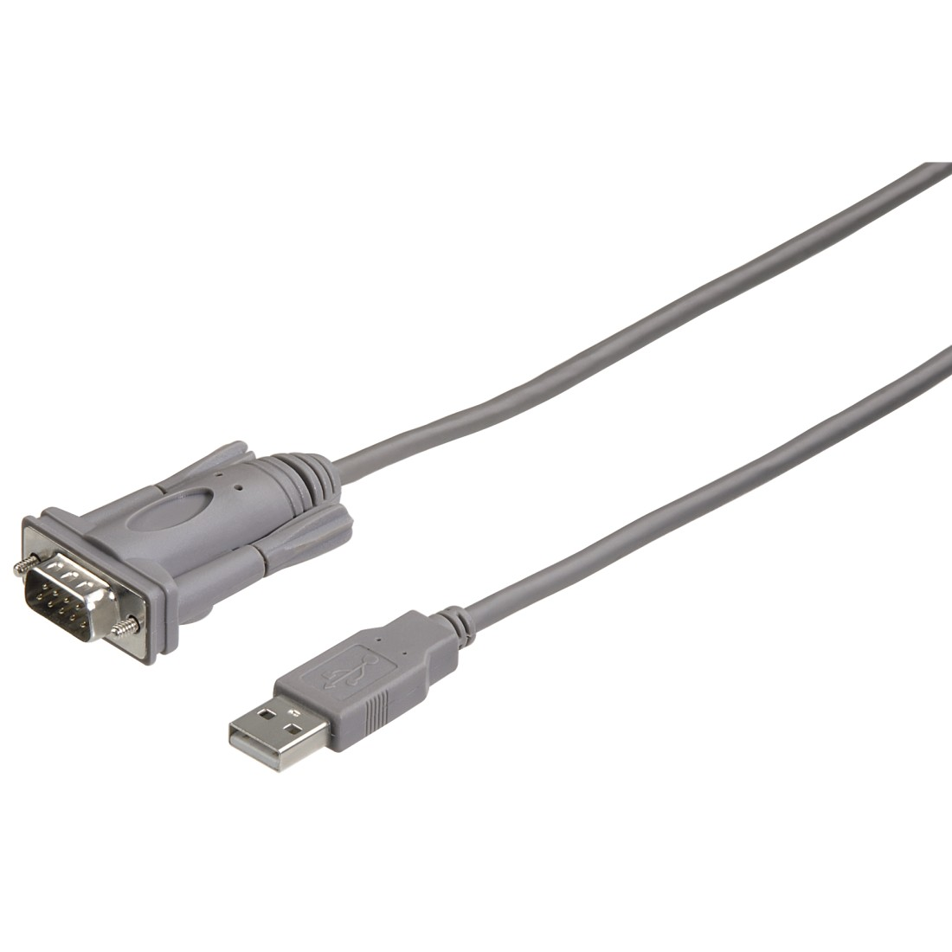
Console Cable
Used to connect to the console of a networking device (switch, router)
Usually a USB to Serial adapter is also required

Slide 13
IP Addresses
Known as logical address
Can be assigned to network and end devices
Essential part in routing
Four bytes (octets), separated with “ . “ Example: 1.3.2.8

Slide 14
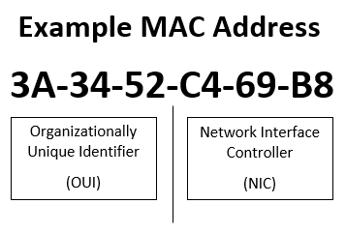
MAC Addresses
Known as physical address
Unique identifier assigned to network interfaces
48 bits or 6 bytes in a hexadecimal format (discussed later in the course)
Can you change it?

Slide 15
What is a MAC Address Used for?
Host-to-host communication
Device Identification and tracking
Static IP Assignment (Matched MAC -> receive IP)
MAC Address Filtering
MAC Address Authentication (ISPs use it, for example)

Slide 16
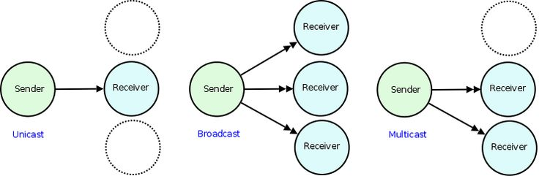
Types of traffic
Unicast
Broadcast
Multicast
(Anycast)

Slide 17
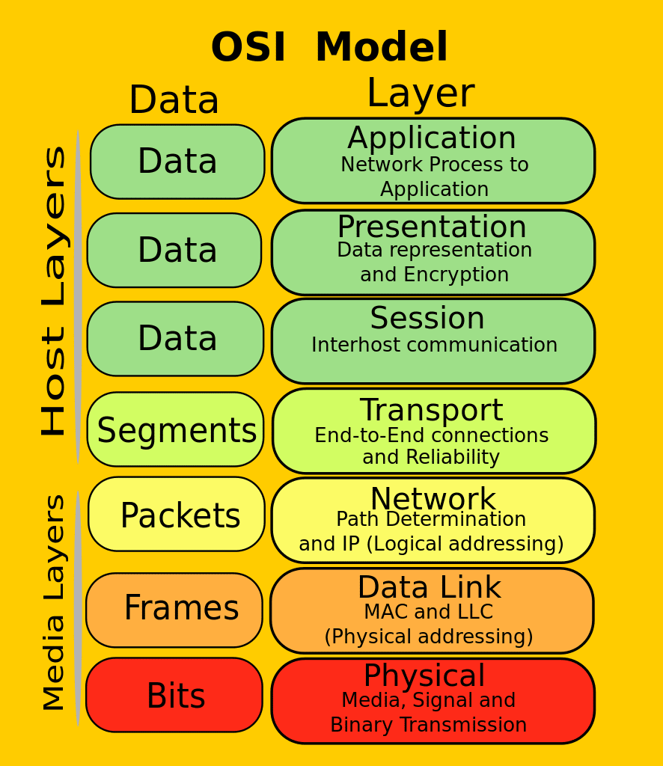
OSI Model
OSI = Open Systems Interconnection
Why?
Organizes the information
Simplifies learning
Standards for the vendors
Easier troubleshooting
Protocol Data Unit (PDU) – different data format at each layer

Slide 18


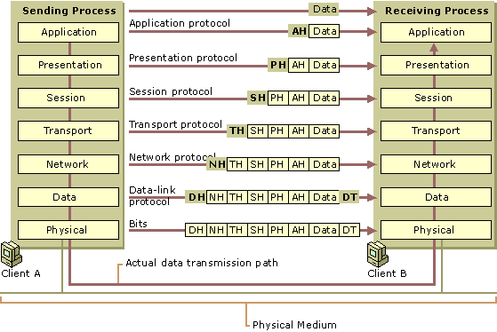
Data Flow in the OSI Model

Slide 19
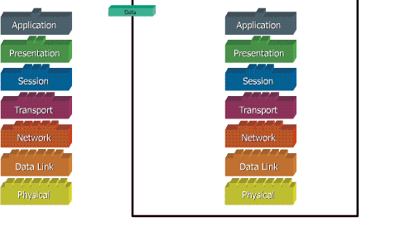
Data Flow in the OSI Model (2)

Slide 20
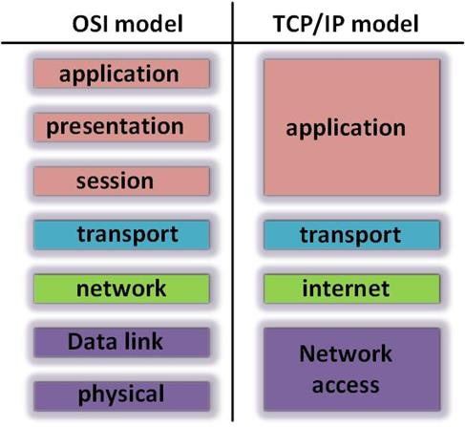
OSI and TCP/IP Models Comparing

Slide 21
Questions
sli.do #NetFund

Slide 22
IP addresses and host-to-host communication

Slide 23
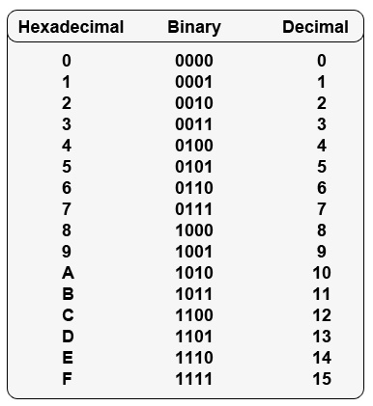
Different numeral systems
Common Numeral Systems in Computer Networking:
Decimal
Binary
Hexadecimal

Slide 24
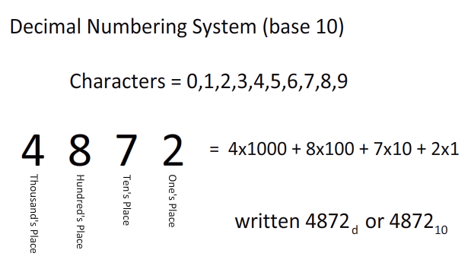
Decimal Numeral System
Base of 10
Called decimal or denary
A single digit can be: 0 1 2 3 4 5 6 7 8 9
In this example:
4x10³ + 8x10² + 7x10¹ + 2x10⁰ =
4000 + 800 + 70 + 2

Slide 25
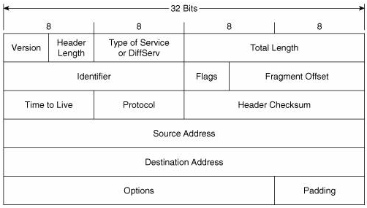
IPv4 Address
Plays important role for device connectivity
It is a 32-bit address
There are 4 294 967 296 IP addresses (2³²)

Slide 26
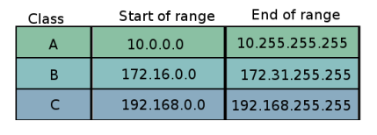
Private IP addresses
Used for addressing internal networks (offices, HQs etc.)
Not routable on the Internet
Can be reused in many networks
Range of private addresses for each class (classes are discussed later)

Slide 27
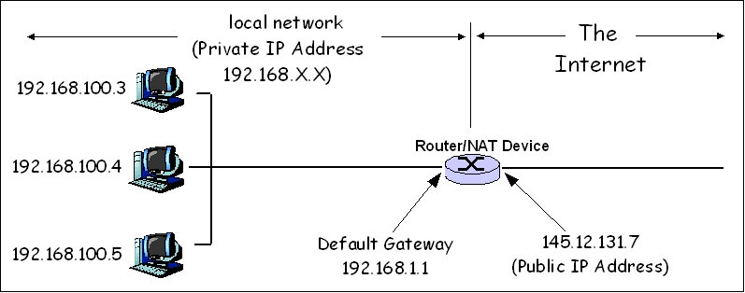
NAT – Network address translation

Slide 28
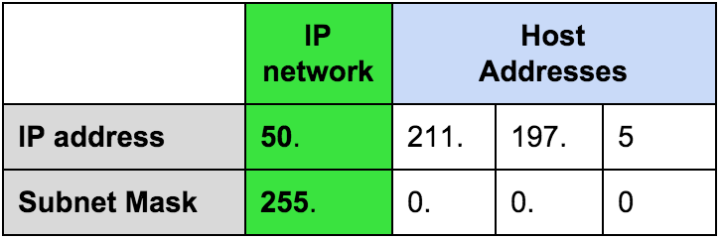
Network masks
Define the border between the network and the hosts part
Segment the network

Slide 29
Network masks example
Network part
Host part
Example:
Host IP address is: 192.168.1.8
Subnet mask is: 255.255.255.0

Slide 30
A quick challenge
10.15.1.0
Is this a valid HOST IP Address?

Slide 31
A quick challenge (2)
Well…it depends!
Let’s see it with /23 mask. 10.15.1.0 /23 can be presented as:
10.15.00000001.00000000
255.255.11111110.00000000
First 23 bits
So, is it a valid host IP Address in this case?

Slide 32
A quick challenge (3)
In the example from the previous slide, which is the first and which is the last possible host address for the subnet to which this IP address belongs?
10.15.1.0 /23
10.15.0.0 is the network address
10.15.0.1 is the first host address
10.15.00000001.00000000
255.255.11111110.00000000
10.15.1.254 is the last host address
10.15.1.255 is the broadcast address

Slide 33
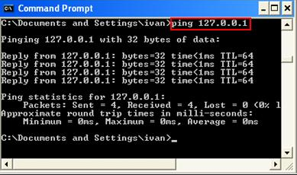
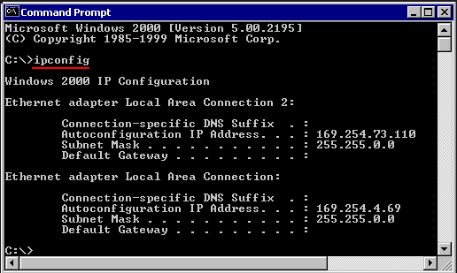
Reserved/Special IP Addresses
There are some special IP addresses. For example:
127.0.0.1 /8
Known as loopback address
On most computer systems, “localhost” resolves to the IP address 127.0.0.1
169.254.X.X /16
When DHCP is not reachable
Known as APIPA (Microsoft)

Slide 34
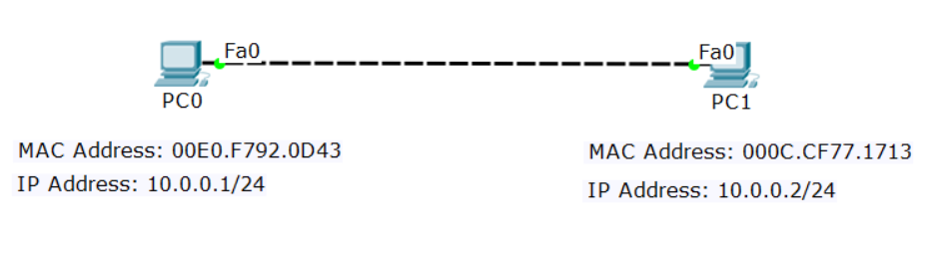
Four addresses required
There are 4 addresses needed for Ethernet communication:
Source IP | Destination IP
Source MAC | Destination MAC

Slide 35
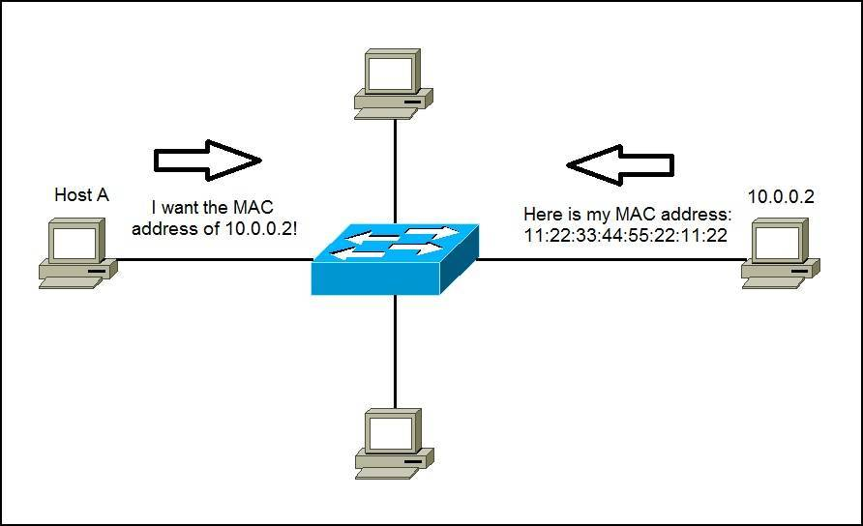
ARP: Address Resolution Protocol
Used to find the MAC address of the destination
Uses Broadcast

Slide 36
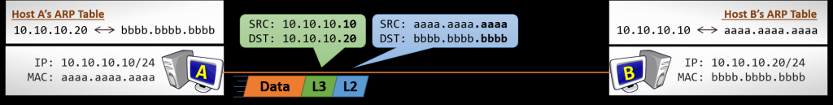
Direct communication (without router)
Source and destination MAC addresses are constant
Source and destination IP addresses are constant

Slide 37
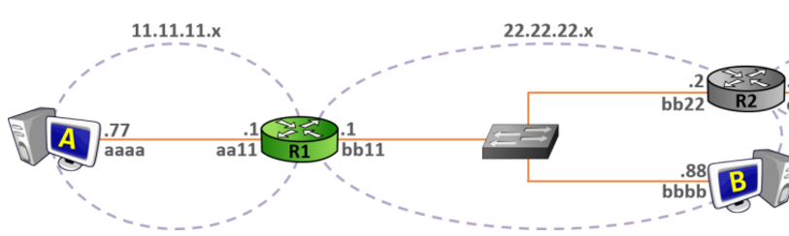
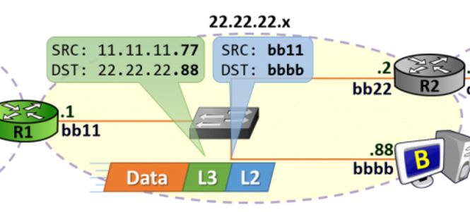
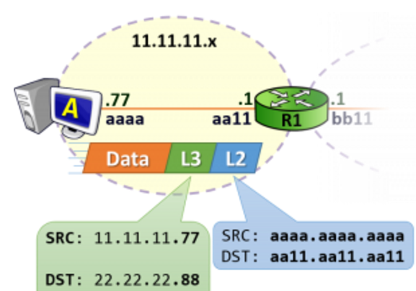
Host-to-Host Communication With Routers

Slide 38
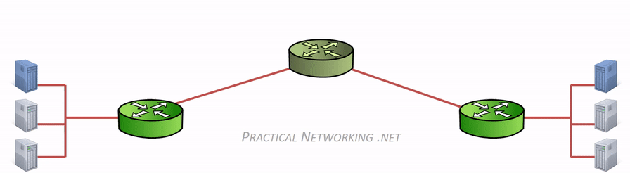
Host-to-Host Communication With Routers (2)
Source and destination MAC addresses are changed at every hop/router

Slide 39
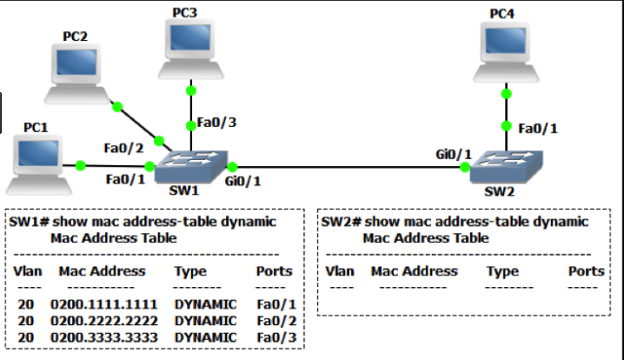
The MAC address table
It is a (dynamic) table that maps MAC addresses to ports
Used to find the proper interface when the switch forwards a packet

Slide 40
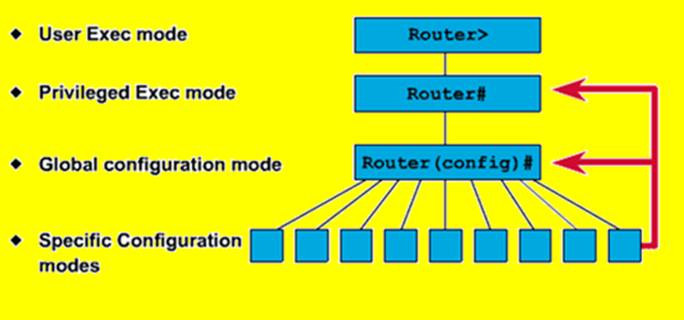
Command Line Introduction
Different vendors use different names but the logic is similar
Typical CLI modes:
Read-only (User)
Read-write (Privilege)
Configuration (Global config)
Sub-configuration

Slide 41
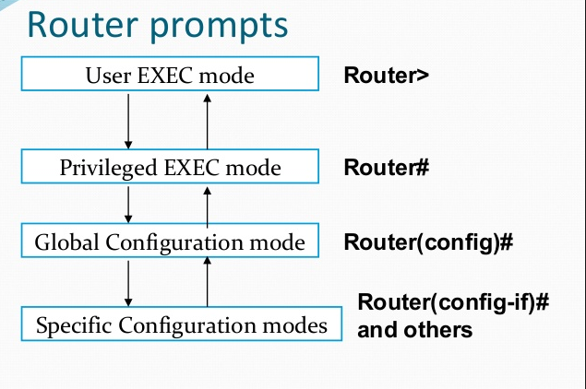
Command line
type “enable”
type “configure terminal”
Interface, VLAN, routing, etc.
to go back, type “exit”

Slide 42
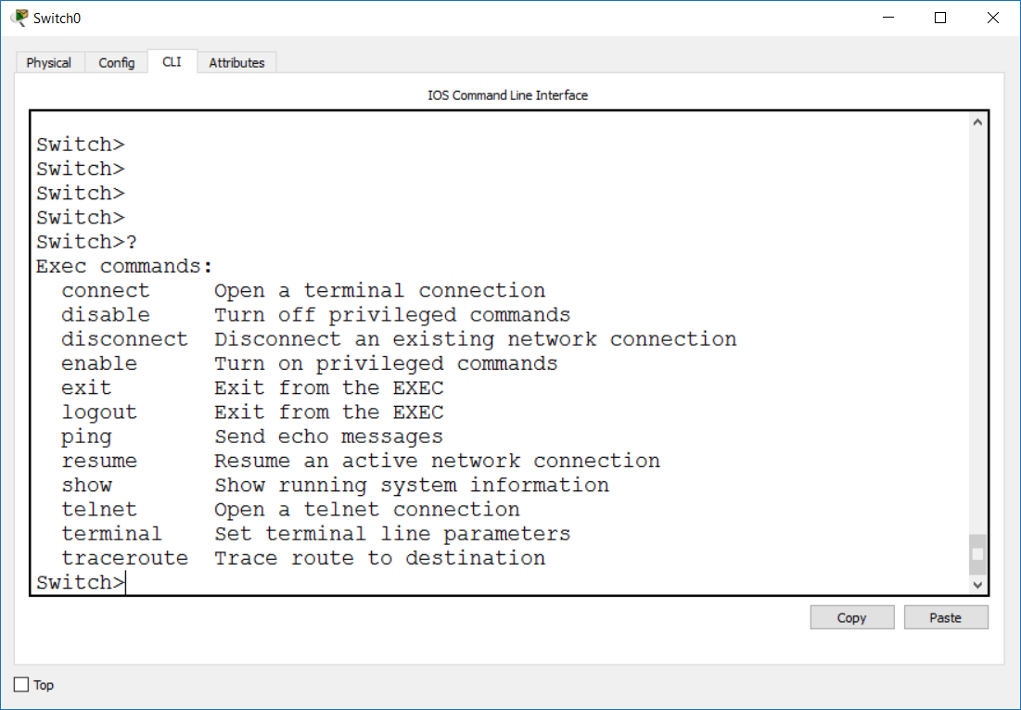
Using the Help – “?”
Use the “?” at each level to see the available commands

Slide 43
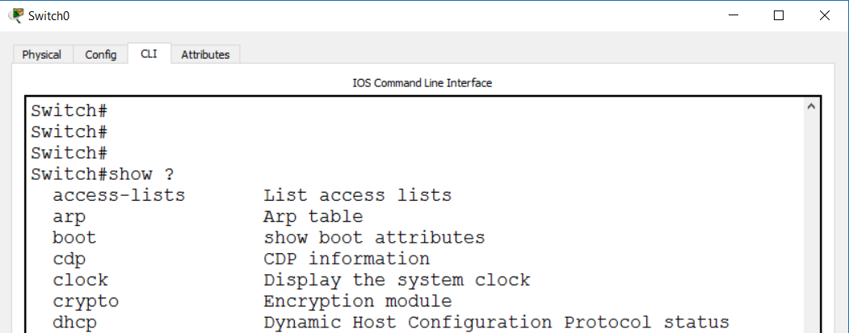
Using the Help – “?” (2)
Use the “?” as you type to see:
how to finish a command
what is/are the next word in the command

Slide 44
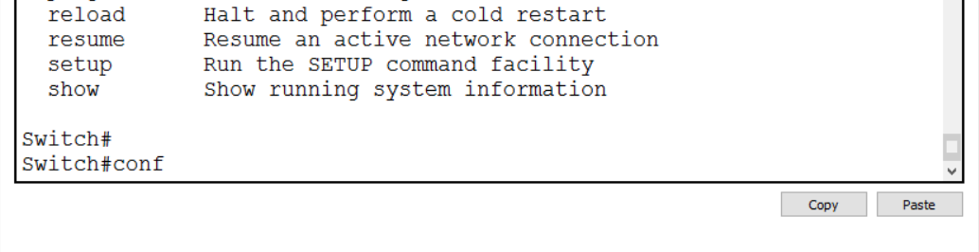
Using the Help – TAB
Hit the TAB key here to autocomplete “configure”

Slide 45
Basic Connectivity Checks
Ping (Layer 3)
Traceroute (Layer 3)
LLDP (Layer 2)
CDP (Layer 2)

Slide 46
Questions
sli.do #NetFund

Slide 47
Network access, security and VLANS

Slide 48
Saving the configuration
The configuration file must be saved to survive reboot
To save the running configuration file (stored in RAM) to the startup configuration file (stored in NVRAM), use either:
copy run start
write memory
running config
startup config
configuration
changes

Slide 49
Loading the configuration
The saved configuration file (startup config file) will go in the RAM (the running config file) when:
the device is restarted
a copy start run command is executed
running config
startup config

Slide 50
Out-of-band vs in-band management
Out-of-band:
Management traffic uses separate path from the user traffic
Typical protocol: Console
In-band management
Management traffic travels the same path as user traffic
Typical protocols: Telnet, SSH, SNMP, Web

Slide 51
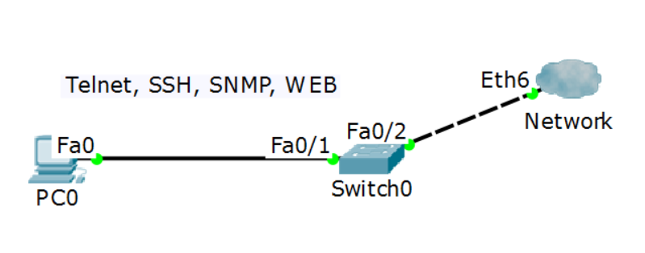
In-band management
Management session on top of existing data connection
Needs L3 connectivity – IP addresses are required
More convenient to use but not always secure and reliable

Slide 52
Secure access - best practices
Physically secure the devices
Use SSH instead of Telnet
Use SNMPv3 instead of v1 or v2
Use HTTPS instead of HTTP
Out-of-band management (console) is considered more secure than in-band management
Create strong passwords for each privilege level and method of access (console, VTY)

Slide 53
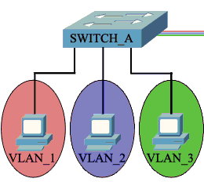
Access (untagged) ports
Used to connect to end-user devices
Can be associated with only one VLAN
Uses the “normal” ethernet frame where there is no VLAN information - no VLAN tag

Slide 54
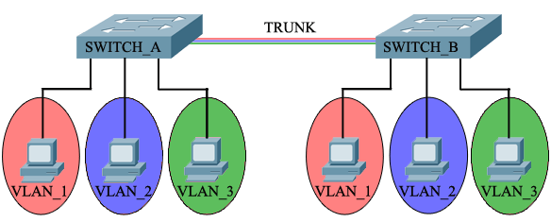
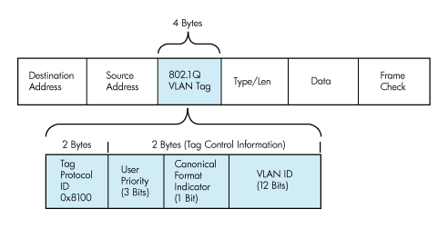
Trunk (tagged) ports
Used to connect between switches
Can carry information from/to multiple VLANs
Uses the 802.1Q tagged frame

Slide 55
Tagging between switches
VLAN 1
Untagged
Untagged

Slide 56
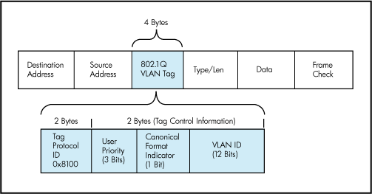
Trunk port details
Uses IEEE 802.1Q tag to identify each frame
A trunk carries multiple tagged VLANs and (maximum) one untagged VLAN
The untagged VLAN on a trunk is called:
Native VLAN (Cisco)
PVID (HPE Comware)
Untagged VLAN (HPE Provision)

Slide 57
Questions
sli.do #NetFund

Slide 58
Layer 2 redundancy - Spanning Tree Protocol

Slide 59
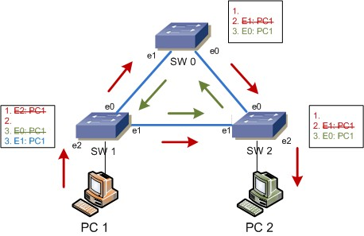
What is the Spanning Tree Protocol?
It addresses a problem which switches can not handle alone: the broadcast storms
Without STP, a L2 loop will:
Overload the links
Affect the end devices
Cause MAC table instability
…never stop

Slide 60
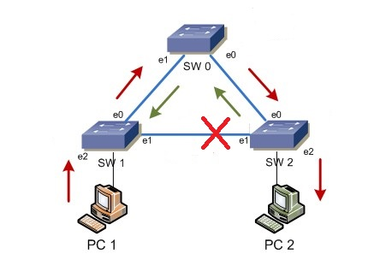
What is the Spanning Tree Protocol? (2)
All STP enabled switches “talk” to each other
The management information that they exchange is in the form of BPDUs (Bridge Protocol Data Units)
The goal is to logically block one or more ports to prevent from loops

Slide 61
The STP algorithm
Elect the Root switch (Root bridge)
This is the switch with the lowest BID (Bridge ID)
BID = Switch Priority and MAC
Select the root ports
They have the best cost (lowest) to the Root
Selected per switch
Select the designated ports
They have the best cost (lowest) to the Root
Selected per segment (connection)
All other ports go to blocking state

Slide 62
STP tie-breakers
If there is a tie situation - the same path cost via different paths, use the following tie-breakers:
When selecting Root port or Designated port, chose the neighboring switch which has the lowest Bridge ID
If the Bridge ID is the same, select the lowest Port ID (PID)
Port ID = Port priority and port number

Slide 63
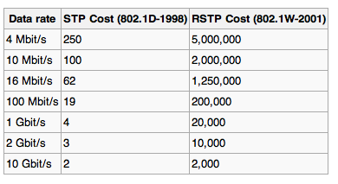
Link costs (path cost)
Higher port speed -> lower cost
The values can be changed by administrator

Slide 64
STP Priority
A number between 0 and 61440
Must be configured in increments of 4096
Default is 32768 (+ the VLAN ID)
The switch with the lowest priority will become the Root
If equal values -> lowest MAC address wins (BID = Priority and MAC)

Slide 65
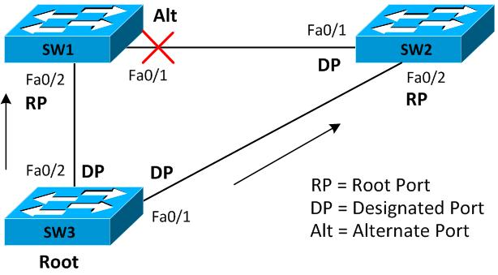
STP Example
Priority 32768
Priority 4096
Priority 0

Slide 66
Spanning Tree Protocol – Main Flavors
STP - Spanning Tree Protocol, IEEE 802.1D
RSTP - Rapid STP, IEEE 802.1W
MSTP - Multiple STP, IEEE 802.1S (802.1Q-2005)
PVST+ - Per-VLAN STP, Cisco proprietary

Slide 67
PVST+
Per-VLAN Spanning Tree is Cisco protocol
Why? It has a similar idea as MSTP -
Creates a spanning tree topology separately
PortFast in PVST+ is similar to Edge port in STP/RSTP
to distribute the load
for each VLAN

Slide 68
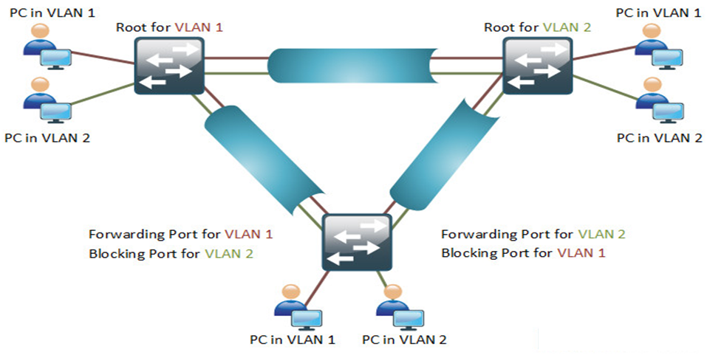
PVST+ (2)

Slide 69

PVST+ (3)
Priority: 0
Priority: 4096
Priority: 4096
Priority: 0
Vlan 1
Vlan 2
Vlan 1
Vlan 2
Switch 1
port 1
Switch 2
port 1
R
R
port 2
port 2
port 1
port 2
Switch 3
Priority: 32768
Priority: 32768
Vlan 1
Vlan 2

Slide 70
The good and the bad about PVST+
PVST+ advantages:
triggers STP calculation only if there is a potential loop in a particular VLAN
detailed “look” of the network – does not block ports when there is no loop on the trunks for a given VLAN
PVST+ disadvantages
generates a lot of overhead in the network
proprietary protocol

Slide 71
Questions
sli.do #NetFund

Slide 72
IP services and basic routing

Slide 73
What is DHCP?
DHCP: Dynamic Host Configuration Protocol
Provides automatic distribution of IP addresses and other networking parameters such as:
Subnet mask
Default gateway
DNS servers
More…
Industry standard

Slide 74
DHCP Components
Server
DHCP scope - range of addresses (pool), lease time, reservations, etc.
Uses port UDP 67
Client
Must be configured to use DHCP
Uses port UDP 68
(Relay agent)
Used to serve multiple (V)LANs with a single DHCP server

Slide 75
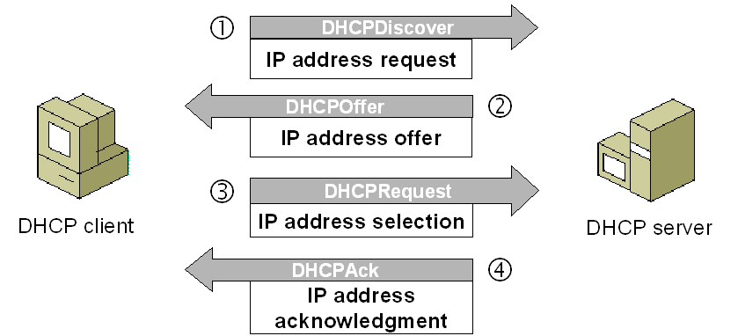
The DHCP Process
“DORA”
Discover
Offer
Request
Acknowledge
All messages use broadcast (IPv4)

Slide 76
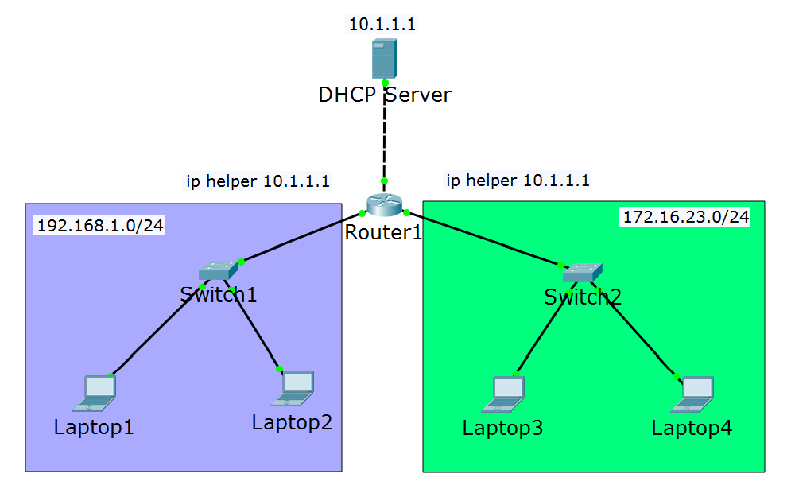
DHCP Relay (2)
Scope settings for 192.168.1.0/24
Scope settings for 172.16.23.0/24

Slide 77
DNS Introduction
DNS: Domain Name System
DNS Usage:
To translate names to IP addresses
To translate IP addresses to names
To find a particular service in the network
*DNS will be discussed in more details in the advanced course

Slide 78
DNS “A” Records
One of the most commonly used records in DNS
Matches a hostname (or FQDN) to an IP address
Examples:
pc1 -> 192.168.1.1
pc2 -> 192.168.1.2
server -> 192.168.1.100
www.abv.bg -> 194.153.145.104
*FQDN = Fully Qualified Domain Name

Slide 79
Switching vs Routing
Switches:
Use Layer 2 information (MAC addresses)
Forwarding decisions based on the MAC address tables
Not scalable for big networks
Routers:
Use Layer 3 information (IP addresses)
Forwarding decisions based on the routing tables
Scalable for large networks

Slide 80
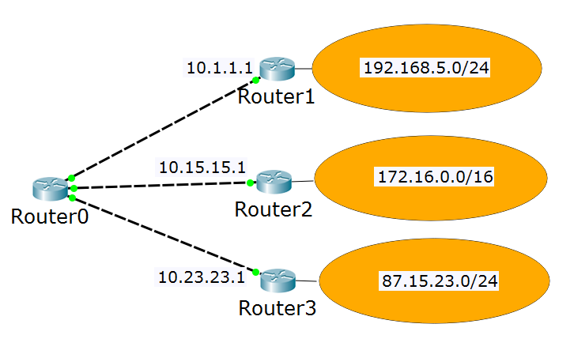
The Routing Table
My routing table:
192.168.5.0/24 via 10.1.1.1
172.16.0.0/16 via 10.15.15.1
87.15.23.0/24 via 10.23.23.1
10.1.1.0/24 is local
10.15.15.0/24 is local
10.23.23.0/24 is local
10.1.1.100
10.15.15.100
10.23.23.100

Slide 81
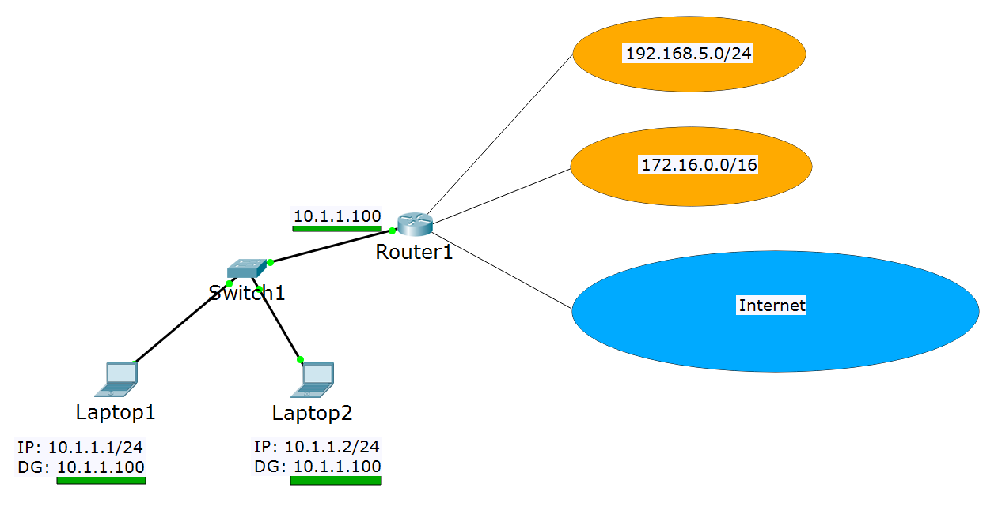
Default Gateway

Slide 82
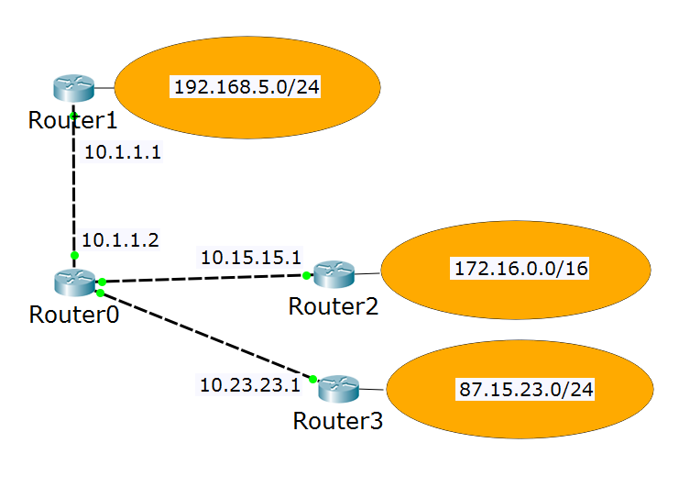
Default Gateway (2)
My routing table:
192.168.5.0/24 is local
10.1.1.0/24 is local
172.16.0.0/16 via 10.1.1.2
87.15.23.0/24 via 10.1.1.2
10.15.15.0/24 via 10.1.1.2
10.23.23.0/24 via 10.1.1.2
OR
192.168.5.0/24 is local
10.1.1.0/24 is local
0.0.0.0/0 via 10.1.1.2 (default gateway)

Slide 83
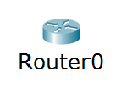
The Rule of the Longest Match
192.168.0.0/16 via 10.1.1.1
192.168.5.0/24 via 10.15.15.1
0.0.0.0/0 via 10.23.23.1
How do I reach 192.168.5.3?
How do I reach 192.168.18.7?
How do I reach 85.12.3.42?
Answer: via 10.15.15.1
Answer: via 10.1.1.1
Answer: via 10.23.23.1

Slide 84

Direct routing

Slide 85

Inter-VLAN Routing Using the Same Switch

Slide 86

Inter-VLAN Routing Using External Switch
Trunk ports

Slide 87

Inter-VLAN Routing Using External Router
Trunk port

Slide 88

Static Routes
10.1.1.0/24 is local
192.168.1.0/24 is local
192.168.1.0/24 is local
192.168.2.0/24 is local
192.168.2.0/24 is local
10.2.2.0/24 is local
192.168.2.0/24 via 192.168.1.2
10.2.2.0/24 via 192.168.1.2
10.1.1.0/24 via 192.168.1.1
10.2.2.0/24 via 192.168.2.3
10.1.1.0/24 via 192.168.2.2
192.168.1.0/24 via 192.168.2.2

Slide 89
Questions
sli.do #NetFund

Slide 90
Dynamic routing with OSPF

Slide 91


Distance-vector vs link-state protocols
Distance-vector protocols
Link-state protocols

Slide 92

RIP Metric: hop count
Note: all routers talk RIP
I know how to reach Destination!
I will use Router1!
I know how to reach Destination!

Slide 93

OSPF Metric: cost
Note: all routers talk OSPF
I know how to reach Destination!
I will use Router3!
slow links
fast links
I know how to reach Destination!

Slide 94

Multiple protocols in the same network
Note: all routers talk RIP and OSPF
RIP: I am better to reach Destination!
?
slow links
fast links
OSPF: I am better to reach Destination!

Slide 95

Administrative distance

Slide 96
Wildcard masks
In the subnet masks, 1 means “do care” and 0 means “don’t care”
Examples:
192.168.1.0 255.255.255.0 -> refers to 192.168.1.0 network
Loopback address: 10.1.1.1 255.255.255.255 -> exact IP address
In the wildcard masks, 0 means “do care” and 1 means “don’t care”
Examples:
192.168.1.0 0.0.0.255 -> refers to 192.168.1.0 network
Loopback address: 10.1.1.1 0.0.0.0 -> exact IP address

Slide 97

OSPF terms: router ID
I have many names (interfaces), but just call me 2.2.2.2
Hi, 2.2.2.2!
Hi, 2.2.2.2!

Slide 98

OSPF terms (2)
Autonomous system
ABR
ABR
ASBR
Area 0 = the backbone area

Slide 99
Wildcard masks
In the subnet masks, 1 means “do care” and 0 means “don’t care”
Examples:
192.168.1.0 255.255.255.0 -> refers to 192.168.1.0 network
Loopback address: 10.1.1.1 255.255.255.255 -> exact IP address
In the wildcard masks, 0 means “do care” and 1 means “don’t care”
Examples:
192.168.1.0 0.0.0.255 -> refers to 192.168.1.0 network
Loopback address: 10.1.1.1 0.0.0.0 -> exact IP address

Slide 100





The “network” command
R1:
network 10.0.0.0 0.0.0.255
20.0.0.1
10.0.0.1
10.0.0.2
R2:
network 10.0.0.0 0.0.0.255
network 20.0.0.0 0.0.0.255
Hello!
Hello!
I have network 10!
I have network 10!
…and 20!
Hello!
I have network 10 and 20!

Slide 101
Single area OSPF configuration
Minimum configuration:
router ospf process_id
router-id number (optional)
network A.B.C.D wildcard_mask area number
Example:
router ospf 1
router-id 1.1.1.1 (optional)
network 192.168.1.0 0.0.0.255 area 0
network 10.0.0.0 0.0.0.255 area 0

Slide 102
OSPF passive interface
The “network” command advertises the network AND sends hello messages out of the interface
What if there is non-OSPF device on the other end of the link?
The Hello packets will be useless
Represents security issues
One solution: use passive interfaces

Slide 103
OSPF passive interface (2)
R1:
network 10.0.0.0 0.0.0.255
20.0.0.1
10.0.0.1
10.0.0.2
G0/1
R2:
network 10.0.0.0 0.0.0.255
network 20.0.0.0 0.0.0.255
Hello!
Hello!
I have network 10!
I have network 10!
…and 20!
Hello!
passive-interface G0/1
I have network 10 and 20!

Slide 104
Questions
sli.do #NetFund

Slide 105
Practice

Slide 106











VLAN 5 (guest): 10.5.5.0/24
Internet
VLAN 10 (corporate): 10.10.10.0/24
Corporate WEB and DNS Server
SSID:
NetFund-Guest
SSID:
NetFund-Corporate
ge1/0/26
fe0/0/0
g0/1
g0/2
ge1/0/25
ge1/0/27
fe0/0/1
Fiber optic

Slide 107
Topology details
DHCP server for both VLANs is the Cisco device
Juniper is making NAT for both VLANs
Device, interface | IP address
Cisco, VLAN 5 | 10.5.5.1
Cisco, VLAN 10 | 10.10.10.1
HP, VLAN 5 | (10.5.5.10)
HP, VLAN 10 | (10.10.10.10)
Corporate server (Web and DNS) | 10.10.10.101
Juniper, VLAN 5 | 10.5.5.100
Juniper, VLAN 10 | 10.10.10.100
Why are the brackets? ☺

Slide 108
Questions
sli.do #NetFund

Slide 109

Summary
1. Introduction to networking
2. IP addresses and host-to-host communication
3. Network access, security and VLANS
4. Layer 2 redundancy – STP
5. IP services and basic routing
6. Dynamic routing with OSPF
7. Practice
…
…
…

Slide 111






СофтУни диамантени партньори

Slide 112






СофтУни диамантени партньори

Slide 113





Trainings @ Software University (SoftUni)
Software University – High-Quality Education, Profession and Job for Software Developers
softuni.bg
Software University Foundation
http://softuni.foundation/
Software University @ Facebook
facebook.com/SoftwareUniversity
Software University Forums
forum.softuni.bg

